Slide 1



Key Words: FR (Face Recognition), QR code (quick response code), Authentication(The process or action of proving or showing something to be true, genuine, or valid)
QR & FACE RECOGNITION BASED DOOR ACCESS SYSTEM
SecurePass AI
Product Brief
1

Slide 2

Agenda
1) Problem Statement
2) Solution
3) System Overview
4) Key Features
5) Graphical User Interface of the System
6) Market Opportunity
2

Slide 3
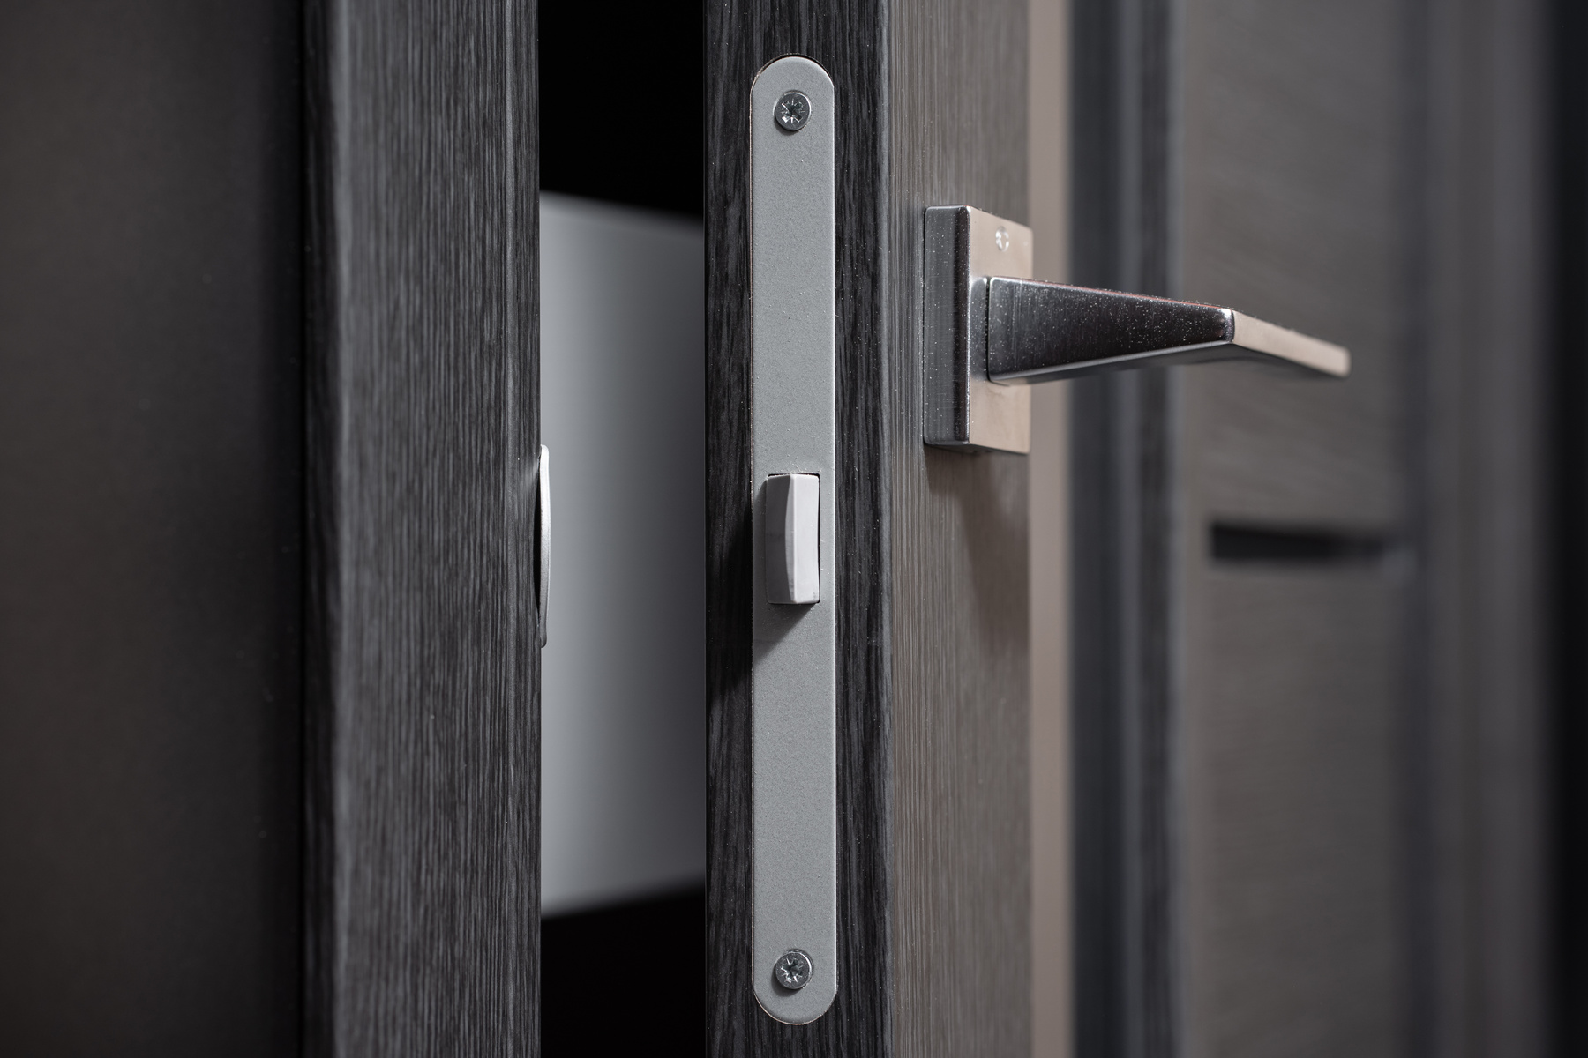
Problem Statement
Traditional door access systems, such as key-based or card-based methods, are increasingly becoming outdated in today's fast-paced and security-conscious environment.
THE NEED FOR AN INNOVATIVE SOLUTION
Door Access System Needs to:
Enhance Security with Dual Authentication Methods.
Eliminate dependency on physical devices.
Offer scalability for deployment across multiple locations.
Provide a seamless experience for both users and administrators.
Traditional door access methods are becoming inefficient, prone to theft, and inconvenient for users.
3

Slide 4
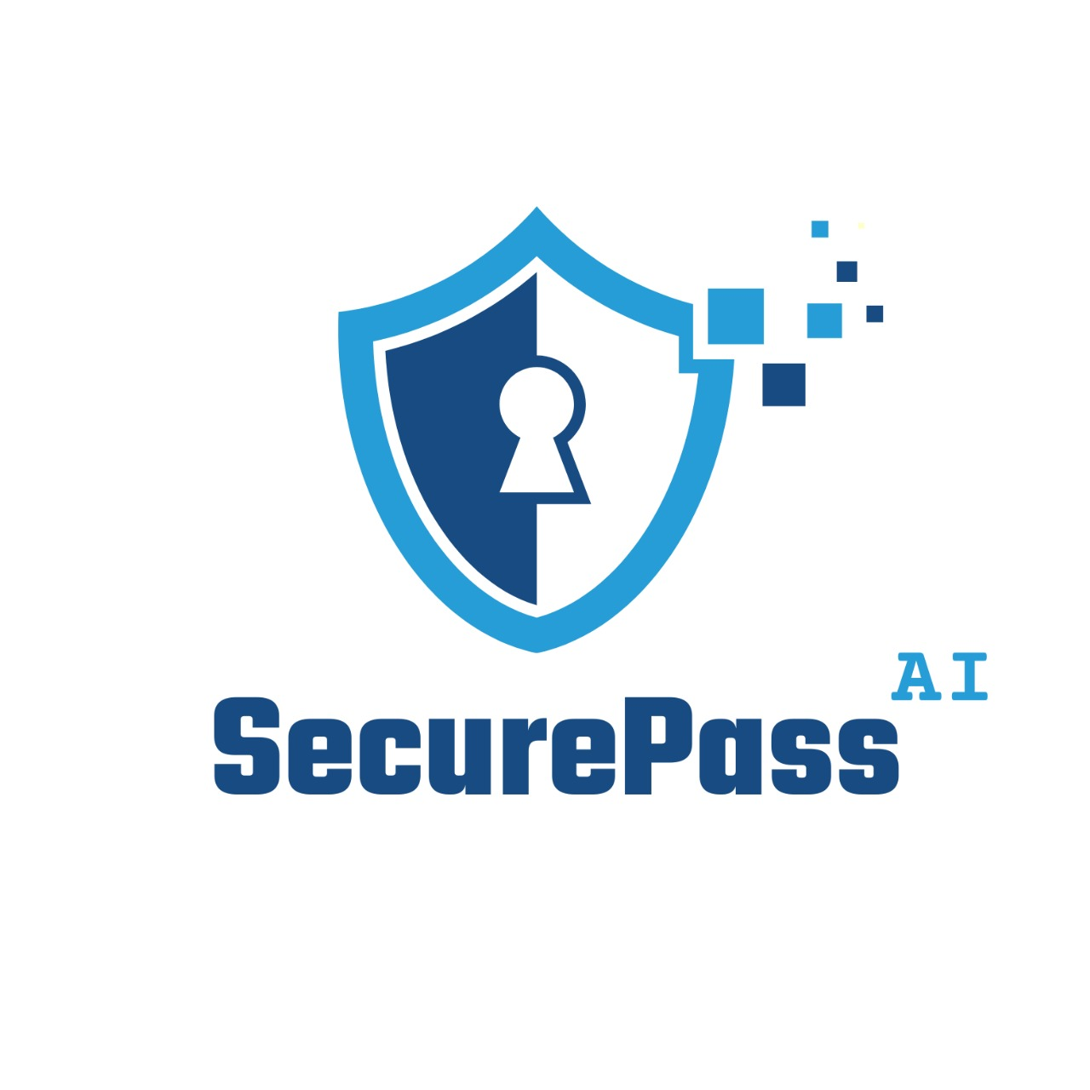

Solution
QR & Face Recognition-Based Door Access System
Introducing SecurePass AI, a revolutionary QR & Face Recognition-Based Door Access System that combines cutting-edge QR code scanning and facial recognition technology into a seamless solution.
This integrated system sets a new standard for modern access control by combining robust security with operational efficiency, offering a scalable and user-friendly solution for any organization.
4

Slide 5
System Overview
SYSTEM COMPONENTS
USER ROLES
A browser-based mobile app: for users to request and manage access.
A web app: for admins to handle user registrations, access approvals, and system monitoring.
Door Lock System: An automated mechanism that unlocks upon successful authentication.
Network Connectivity: Includes Wi-Fi or Ethernet to connect the system to the server for data synchronization.
Database: Stores user credentials, and facial data securely. Logs all access activity (successful or denied).
Super Admin:
Add and manage company admins.
Oversee system-wide configurations and operations.
Admins:
Manage user accounts and access permissions.
Generate and assign QR codes.
Approve or reject access requests.
Monitor system logs for suspicious activities.
Users:
Register and log in to the mobile app.
Submit facial data for authentication.
Request access to specific doors.
Authenticate access via QR code and facial recognition.
5

Slide 6
System Overview Cont.
HOW IT WORKS(USER FLOW)
Permission Request Submission
Users register their face and basic details in the system via the app .
Users can request access to specific doors for a defined date and time.
Users can view the status of their requests under the My Permission section.
After Permission Approved
User arrives at the entry and log in to the application.
User scan QR code at there and verifies identity using facial recognition.
The system verifies the user’s identity and triggers access to the designated area.
Once the user completes their session, they can leave by marking through the application.
6

Slide 7
Key Features
Combines QR code scanning with facial recognition for enhanced security.
Dual Authentication
Browser-Based Mobile App
Enables users to request and manage access easily.
Provides real time status for access approvals or denials through app.
Designed for admins to handle user registrations and permissions.
Allows monitoring of access logs and system configurations.
Supports generating and managing QR codes.
Centralized Web Application
Super Admin Management
Oversees the addition and management of company administrators.
Controls system-wide configurations for scalability and efficiency.
Enables users to contact admins through a "Contact Us" page, view admin responses via the app's notification icon, and facilitates real-time communication for resolving queries efficiently.
Messaging System
7

Slide 8
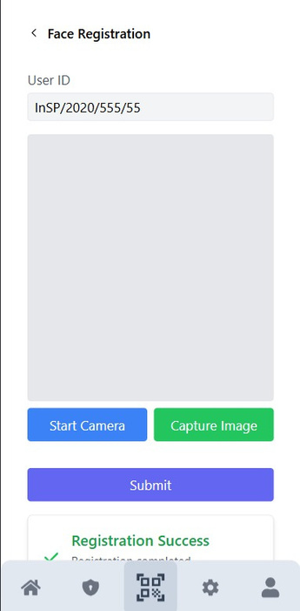
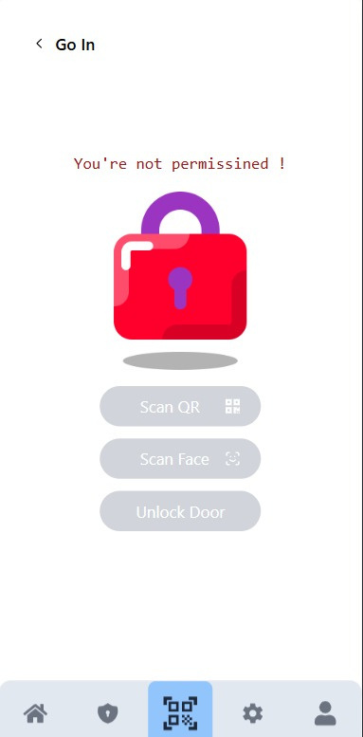
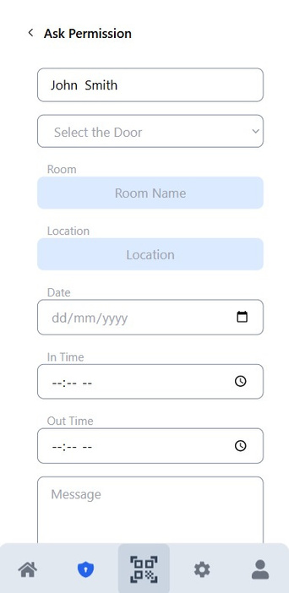
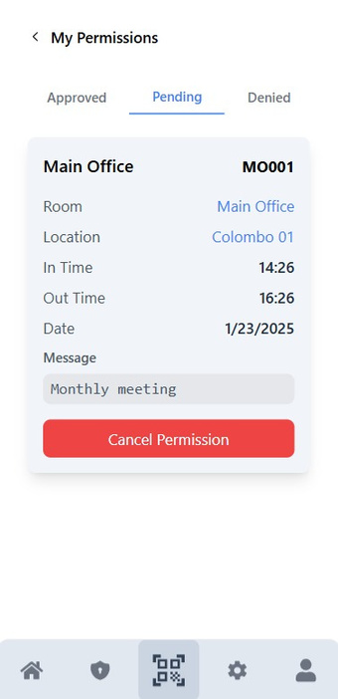
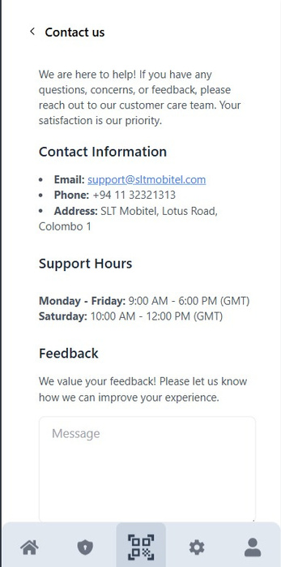
Graphical User Interface of the System
BROWSER-BASED MOBILE APPLICATION
8

Slide 9
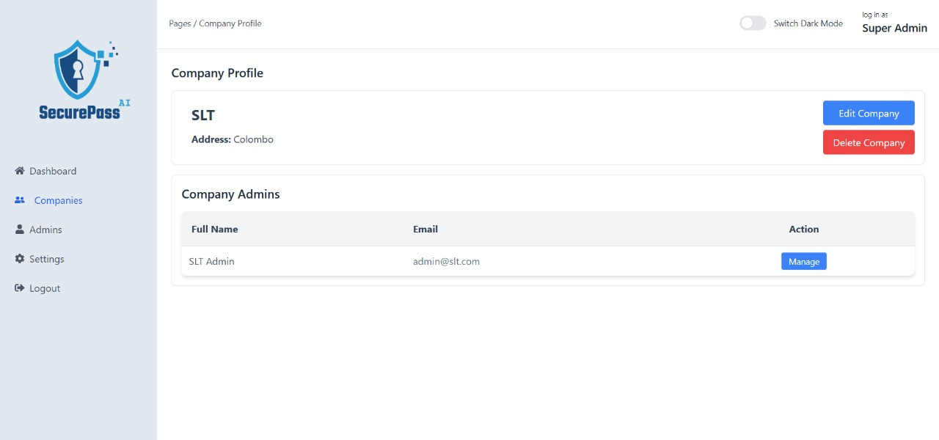
Graphical User Interface of the System
THEME CHANGING
PROFILE MANAGEMENT
THE WEB APPLICATION FOR SUPER-ADMINS
WEB DASHBOARD
COMPANIES MANAGEMENT
ADMINS
MANAGEMENT
ACCOUNT
SETTINGS
LOGOUT
9

Slide 10
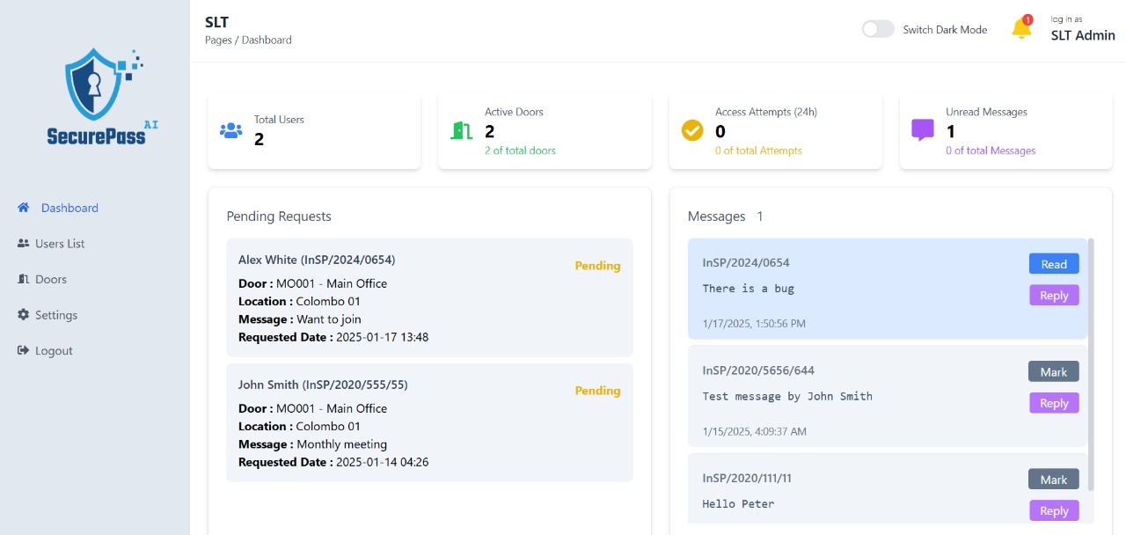
Graphical User Interface of the System
THEME CHANGING
PROFILE MANAGEMENT
THE WEB APPLICATION FOR COMPANY-ADMINS
WEB DASHBOARD
USER MANAGEMENT
DOORS
MANAGEMENT
ACCOUNT
SETTINGS
LOGOUT
10

Slide 11
Market Opportunity
Target Market
Competitive Advantages
Our system is tailored for organizations and facilities that demand advanced access control solutions, including:
Corporate Offices: Enhance security for restricted areas and streamline employee access.
Educational Institutions: Secure campuses and manage student and staff access efficiently.
Healthcare Facilities: Safeguard sensitive areas such as operating rooms and data centers.
Residential Complexes: Provide tenants with a secure, hassle-free access system.
Government Facilities: Ensure high-level security for sensitive operations and offices.
Event Venues: Manage access for staff and attendees at large-scale events.
Dual Authentication: Combines QR code scanning and facial recognition for maximum security.
User-Friendly Interfaces: Simplifies access management for users and administrators.
Scalable Architecture: Adapts to the needs of small businesses and large enterprises alike.
Real-Time Monitoring: Provides admins with instant visibility into access activities and logs.
Cost-Effective: Minimal hardware requirements reduce installation and maintenance costs.
Flexibility: Supports integration across various industries and customizable workflows.
Enhanced Auditability: Detailed logs ensure transparency and compliance with security protocols.
11

Slide 12
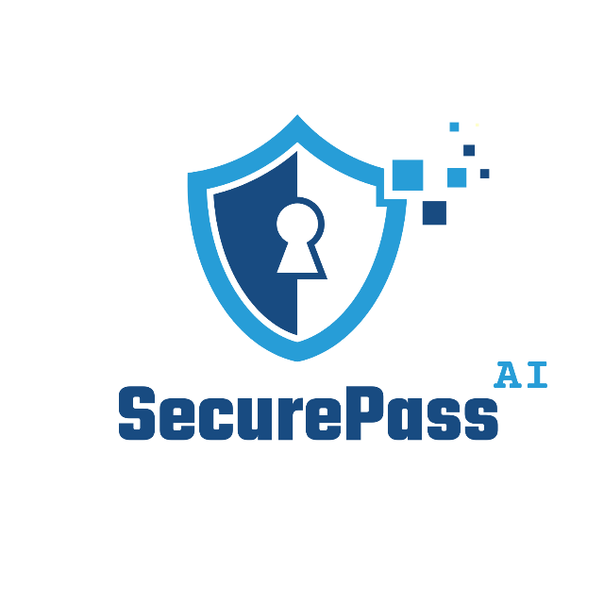
Thank
You
Find Us On Our Website
http://securepass.sltdigitallab.lk

